Slide 1
NLP

Slide 2
Machine Translation
Decoding

Slide 3
Decoding
Find a translation that maximizes P(F|E)P(E)
NP-complete for IBM model 1
Use a phrase translation table (e.g., Koehn’s Pharaoh system, 2004)
Use A* search to find the subset of phrase translations that covers the source sentence
Combine with beam search

Slide 4
Machine Translation
Syntax in Machine Translation
(includes slides from Philipp Koehn)

Slide 5
Notes
Bilingual CKY parsing
 | e1 | e2 | e3 | e5 | e6 | e7 | e8
f1 |  |  |  |  | N/N
f2 |  |  |  | V/V
f3 |  |  | N/N
f4

Slide 6
Notes
Bilingual CKY parsing
 | e1 | e2 | e3 | e5 | e6 | e7 | e8
f1 |  |  |  |  | NP/NP
f2 |  |  |  | V/V
f3 | NP/NP
f4

Slide 7
Notes
Bilingual CKY parsing
 | e1 | e2 | e3 | e5 | e6 | e7 | e8
f1 |  |  |  | VP/VP
f2
f3 | NP/NP
f4

Slide 8
Notes
Bilingual CKY parsing
 | e1 | e2 | e3 | e5 | e6 | e7 | e8
f1 | S/S
f2
f3
f4

Slide 9
String to Tree Translation
I
semantics
semantics
syntax
syntax
phrases
phrases
F
E
(Yamada and Knight 2001)

Slide 10
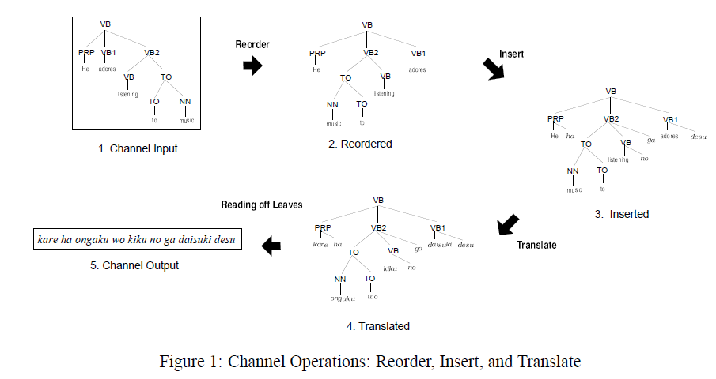
String to Tree Translation
(Yamada and Knight 2001)

Slide 11
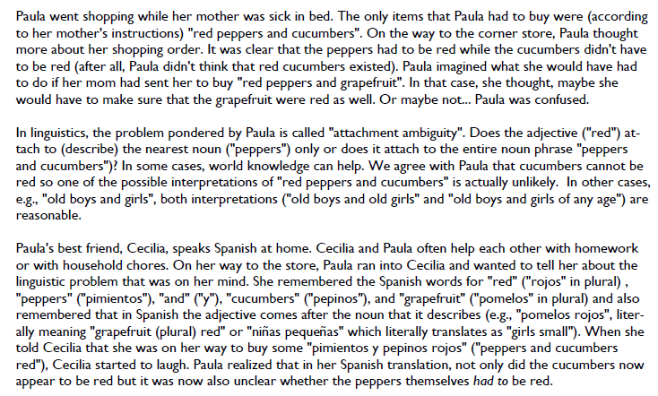
NACLO Problem #1

Slide 12
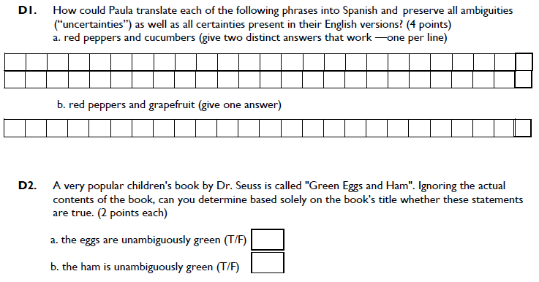
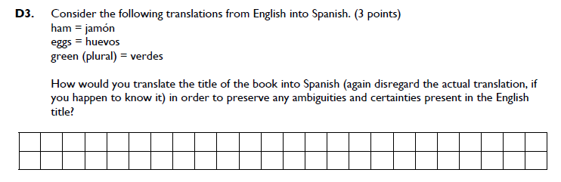

Slide 13
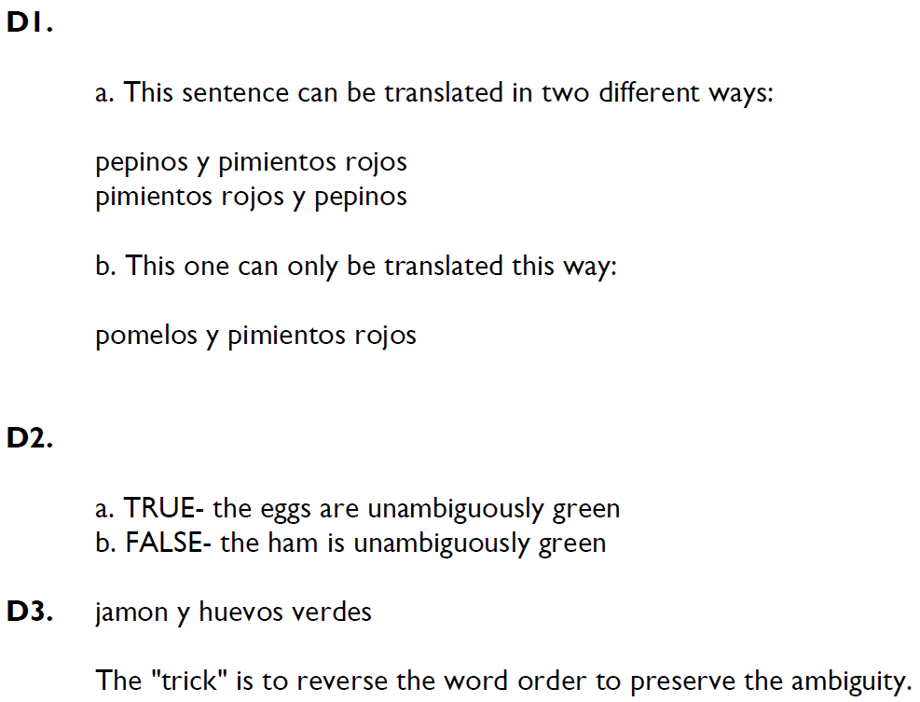
NACLO Solution #1

Slide 14
Clause restructuring (Collins et al.)
Ich werde Ihnen den Report aushaendigen … damit Sie den eventuell uebernehment koennen.
I will pass_on to_you the report, so_that you can adopt that perhaps
verb initial: that perhaps adopt can -> adopt that perhaps can
verb second: so that you adopt…can -> so that you can adopt
move subject: so that can you adopt -> so that you can adopt
particles: we accept the presidency *Particle* -> we accept the presidency
(in German, split-prefix phrasal verbs are very common, e.g., “anrufen” -> “rufen sie bitte noch einmal an” – call right back please)

Slide 15
Synchronous Grammars
Generate parse trees in parallel in two languages using different rules
E.g.,
NP -> ADJ N (in English)
NP -> N ADJ (in Spanish)
ITG (Inversion Transduction Grammar) [Wu 1995]
Don’t allow all permutations in derivations
Only <> and [ ] are allowed

Slide 16
NACLO problem #2
[Problem by Jonathan May]

Slide 17
NACLO problem #2

Slide 18
NACLO problem #2

Slide 19
NACLO solution #2

Slide 20
NACLO solution #2

Slide 21
NLP

